Slide 1
Billy Mayes
“IT’S A NATURAL RESOURCE. BUT IT’S NOT UNLIMITED.”

Slide 2
Materials

Slide 3
What’s a material ?
A material is a material of natural or artificial origin that humans use and/or design to manufacture objects, construct buildings or machines.
Wood
Metals
Ceramics
Glass
Plastics
Rubber

Slide 4
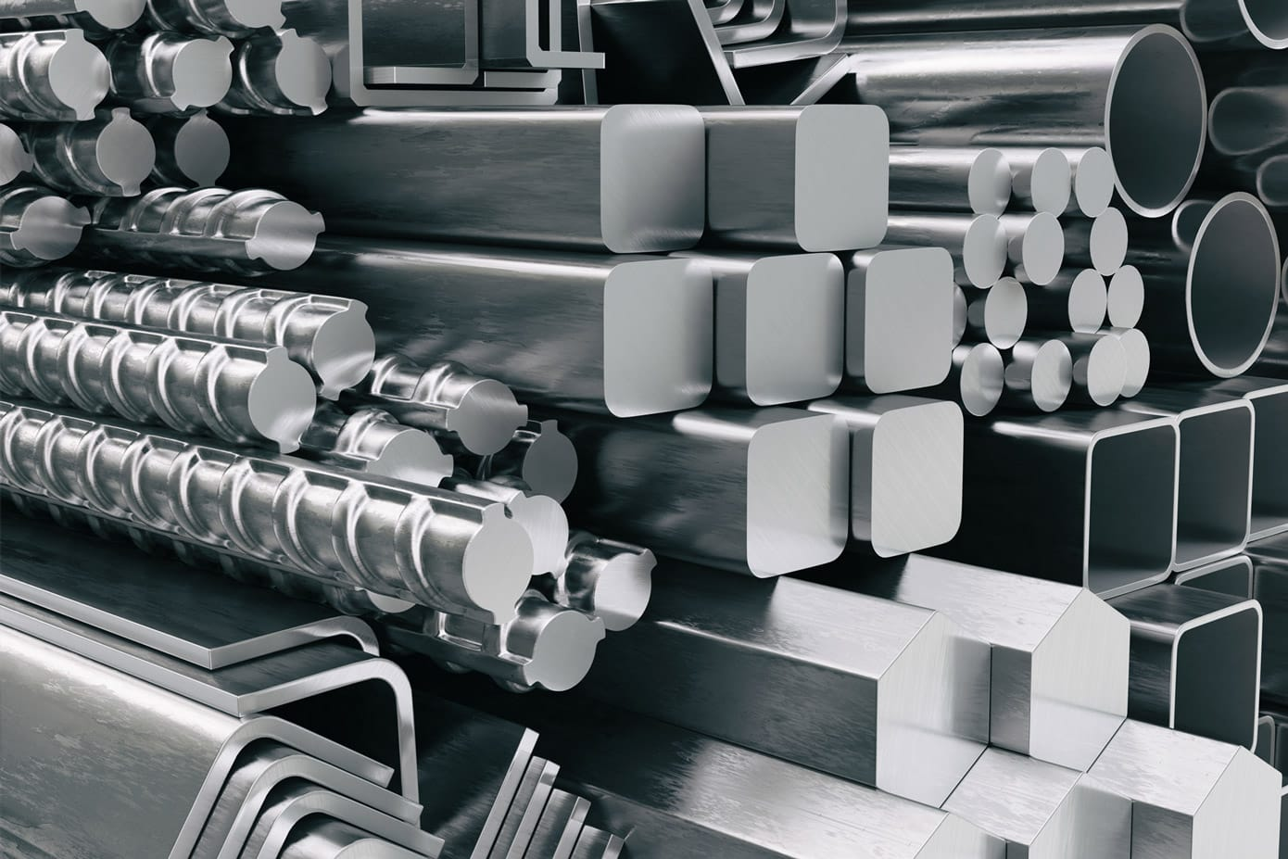

Slide 5
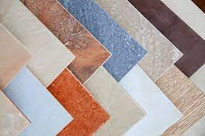

Slide 6
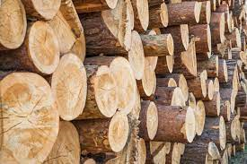


Slide 7


Slide 8
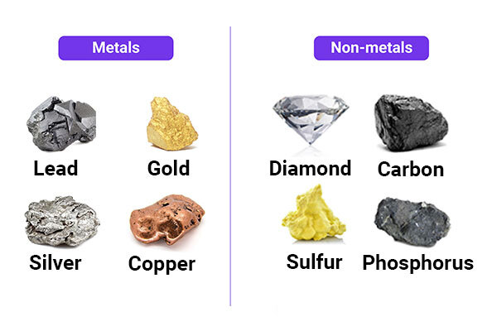

Slide 9


Slide 10


Slide 11
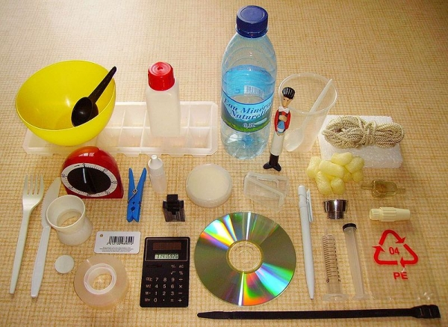

Slide 12


Slide 15
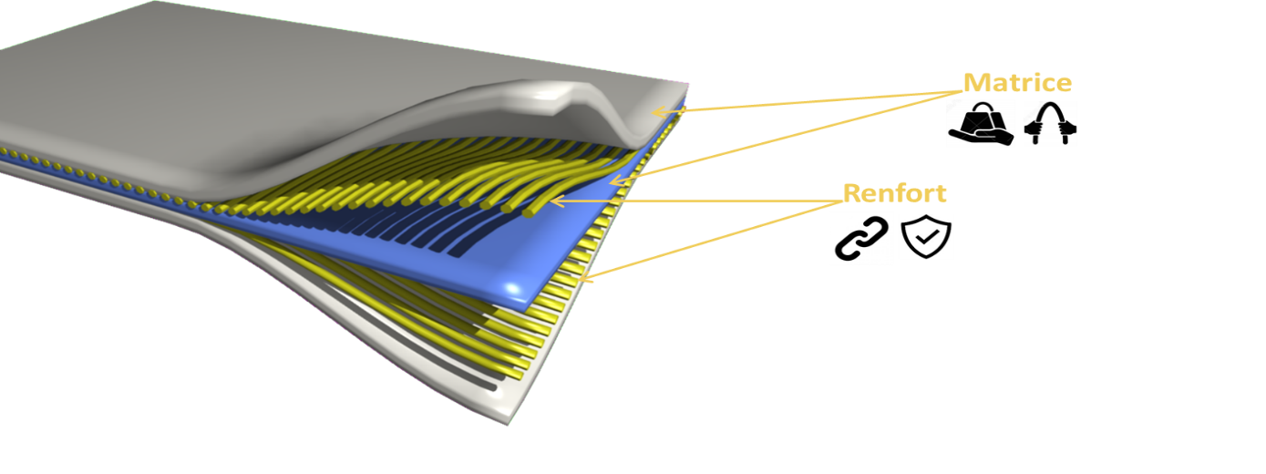
Composites
A composite material is a combination of two materials with different physical and chemical properties. When combined they produce a material that is specific to a certain work, for instance, to become stronger, lighter, or resistant to electricity and also improve strength and stiffness.

Slide 16
Properties of composites materials
The tensile strength of composite
materials is 4-6 times higher than
conventional materials such as
steel, aluminum, etc.
They have better torsion and
stiffness properties.
It has a high fatigue endurance
limit
Low embedded energy.
Composites make less noise during operation and provide less vibration.
Composite materials are additional versatile.

Slide 17
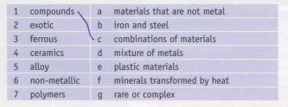





Exercise
1.C
2.g
3.b
4.f
5.d
6.a
7.e

Slide 18
02
Breaking System

Slide 19
Definition
a mechanical device that inhibits motion by absorbing energy from a moving system.

Slide 20
Charactristics
01
02
03
-the materials used to make pads include compounds of advanced materials (cars)
-most braking systems wastes energy because they use friction
-the materials used for the brakes on racing cars should have the ability to generate high levels of friction

Slide 21
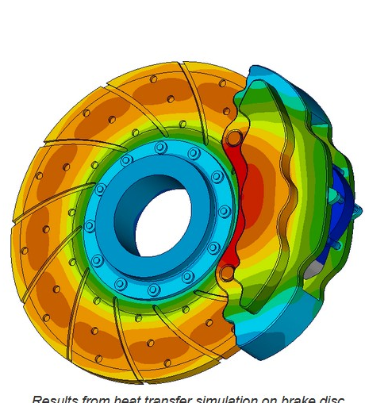
heat soak
heat from the brakes brewing absorbed by the chassis, which can damage sensitive parts

Slide 22
We all know that pushing down on the brake pedal slows a car to a stop. But how does this happen?

Slide 23
When you depress your brake pedal, your car transmits the force from your foot to its brakes through a fluid.
Mechanical advantage (leverage)
Hydraulic force multiplication

Slide 24
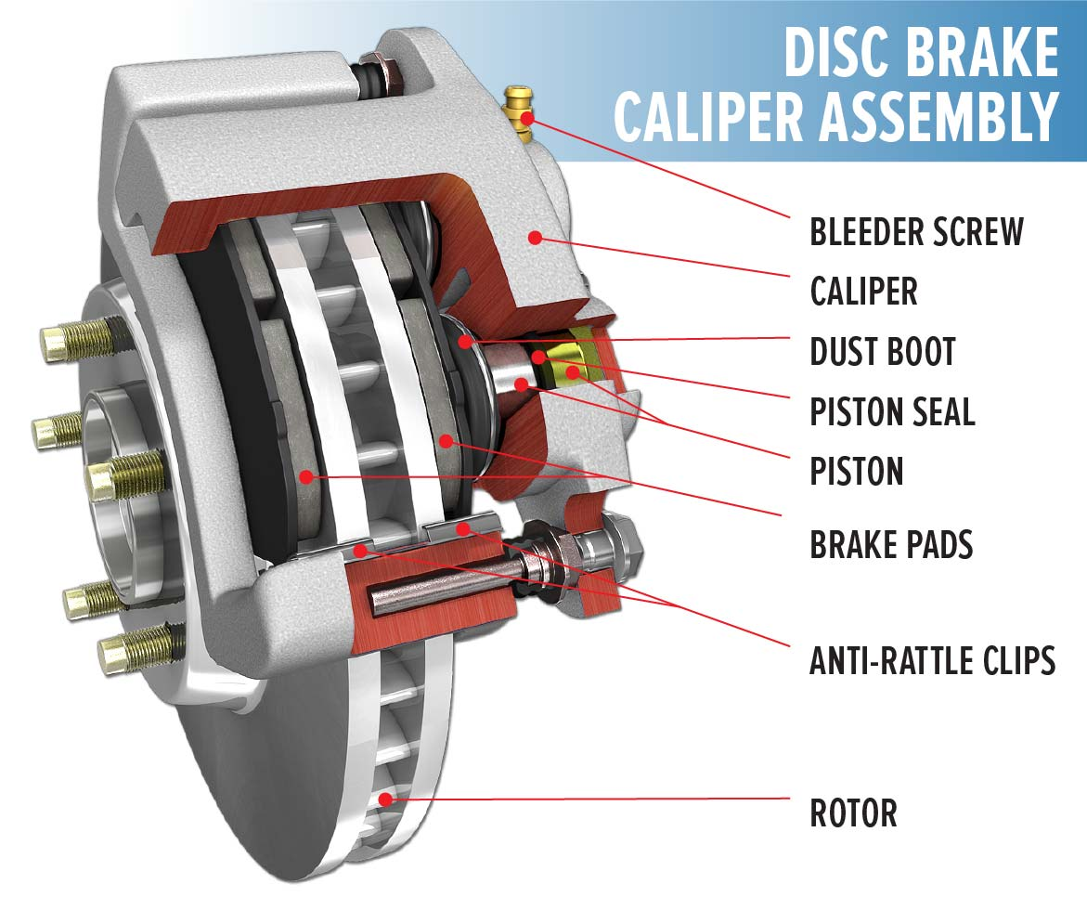

Slide 25
brake pad materials
Non-metallic materials
Semi-metallic materials
Fully metallic materials
Ceramic materials

Slide 26
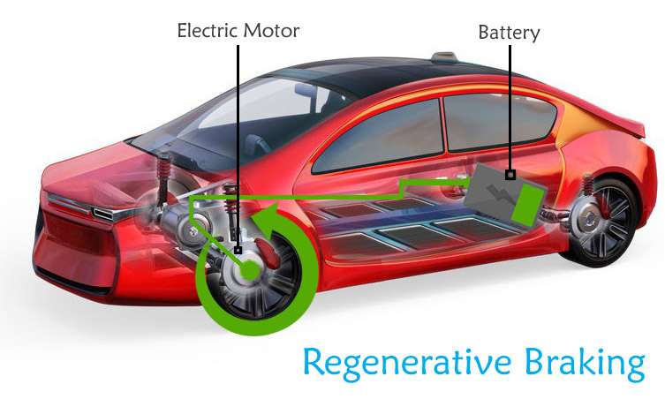
Regenerative braking :
Regenerative braking is an energy recovery mechanism that slows down a moving vehicle or object by converting its kinetic energy into a form that can be either used immediately or stored until needed.

Slide 27
Wire vs cable
03

Slide 28
The the basic difference between Wires and Cables
Wire
Cable
A wire is measured by diameter. According to the diameter of the wire, it will be measured by a gauge number.
A cable contains a hot wire carrying the current, a neutral wire to complete the loop and a grounding wire as well. A cable is classified by the total number of wires it is made up of and their gauge.

Slide 29
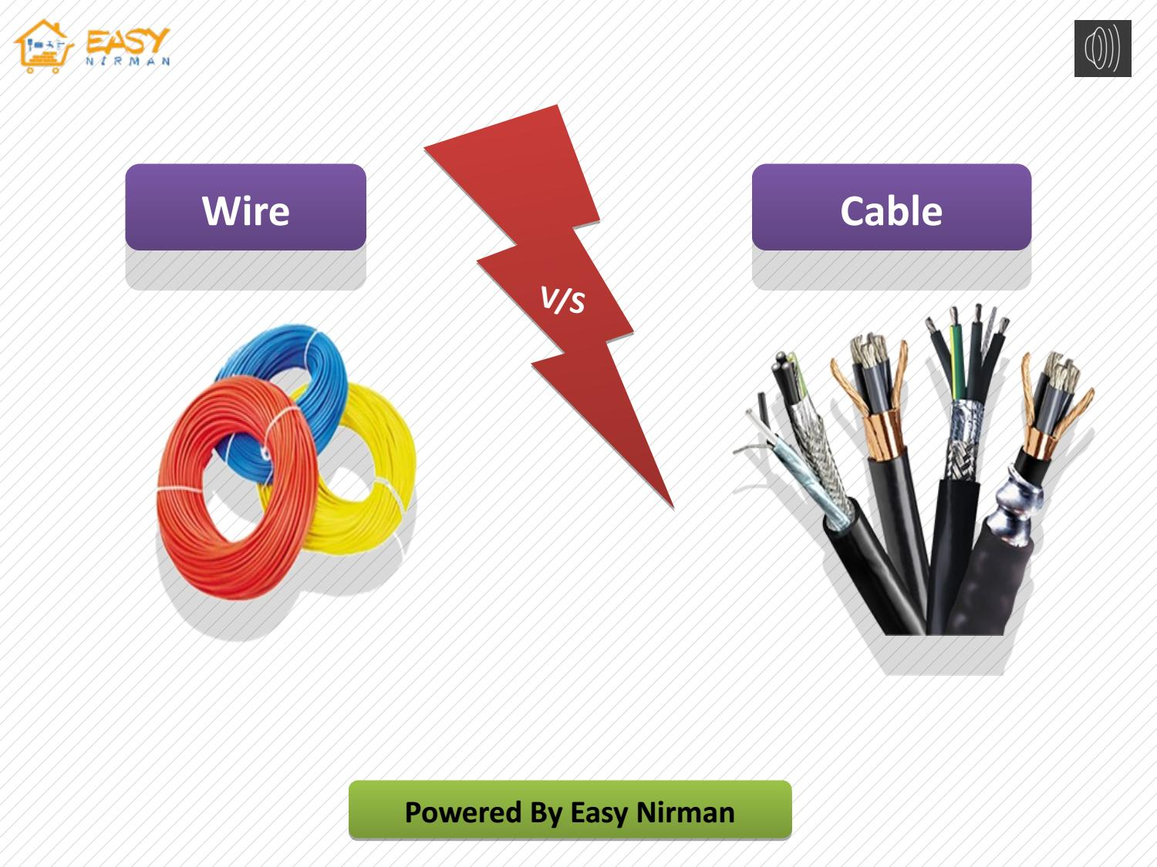
A Picture of Cable and Wire

Slide 30
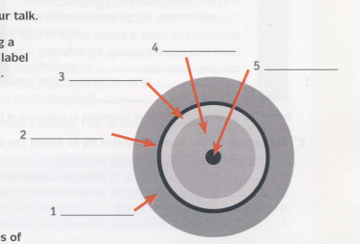
high-voltage cable
1-outer jaket
2-water proof membrane
3-armoured protection
4-insulation
5-condutor

Slide 31

Categories of materials
a insulation
b waterproof membrane
c outer jacket
d armoured protection
e conductor

